Slide 1
SOF 103
C and C++ Programming
Chapter 4
Arrays

Slide 2
Chapter Overview
Review.
Precision issues for float, double ?
Arrays
Multidimensional Arrays
Compiled by Dr.Hew

Slide 3
Basic Data Type
There are 10 basic / primitive data types in C++.
Category | Type | Bytes
Integers | bool | 1
 | char | 1
 | int | 4
 | short | 2
 | long | 4
 | Unsigned int | 4
 | Unsigned short | 2
 | Unsigned long | 4
Fractional numbers | float | 4
 | double | 8
2. Data Types

Slide 4
climits
#include<iostream>
#include<climits>
using namespace std;
int main()
{
cout<<INT_MIN<<" "<<INT_MAX<<endl;
cout<<SHRT_MIN<<" "<<SHRT_MAX<<endl;
cout<<LONG_MIN<<" "<<LONG_MAX<<endl;
return 0;
}
  For more details, please refer to https://www.cplusplus.com/reference/climits/

Slide 5
sizeof operator
#include<iostream>
using namespace std;
int main()
{
cout<<sizeof(int)<<endl;
cout<<sizeof(float)<<endl;
cout<<sizeof(bool)<<endl;
double d=3.142;
cout<<sizeof(d)<<endl;
return 0;
}

Slide 6
overflow
Storing a value that is “too large” to a variable.
#include<iostream>
using namespace std;
int main()
{
short s1 = 32764, s2;
for(int i=0; i<10;i++)
{
s2=s1+i;
cout<< s1+i<<"\t"<<s2<<endl;
}
return 0;
}

Slide 7
char
char means a character:
Use 1 byte to store letters, numbers, symbols, and special characters such as the newline character.
It is also an integer. These characters are encoded with the ASCII(American Standard Code for Information Interchange) code.
Using ‘’ marks to make the char literal: char c= ‘A’; char = 65;
AVOID doing arithmetic on char.

Slide 8
ASCII code table (coding)
#include<iostream>
using namespace std;
int main()
{
char c;
for(int i=33; i<126;i++)
{
cout<<i<<" ";
c =i;
cout<<c<<endl;
}
return 0;
}

Slide 9
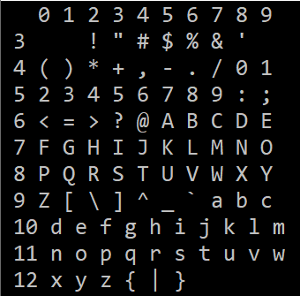
Challenge !
Let print out the ASCII code as shown below:

Slide 10
2. Precision issues for float, double ?
int main()
{
int problemCase = 0;
for (int i=0; i<10;i++)
{
float f = sqrt(i);
cout<<f<<" "<<f*f<<" ";
if(f*f !=i)
{
cout<<" problem!";
problemCase++;
}
cout<<endl;
}
cout<<" Precision issues found: "<<problemCase;
return 0;
}

Slide 11
Let check the error
#include<iostream>
#include<math.h>
#include<iomanip> //setprecision()
using namespace std;
int main()
{
for (int i=0; i<10;i++)
{
float f = sqrt(i);
cout<<i<<" "<<setprecision(10)<<f*f<<" ";
cout<<endl;
}
return 0;
}

Slide 12
3. Arrays
A data structure that stores multiple data items
The elements of arrays are contiguous in computer memory
Arrays store homogenous data items
Arrays have a fixed size
The total elements in an array are called length/size of the array

Slide 13
Why Arrays?
To handle many data items of the same data types
If we want to calculate the average marks of 30 students
  We must use 30 variables which is difficult/inefficient to declare and handle

Slide 14
Why Arrays?
Find the Average of 10 Students’ Marks without Array
  int m1, m2, m3, m4,m5, m6, m7, m8, m9, m10;
  int sum = 0, average = 0;
  cout<<"Enter a number "; cin>> m1;
  cout<<"Enter a number "; cin>> m2;
  cout<<"Enter a number "; cin>>m3;
  cout<<"Enter a number "; cin>> m4;
  cout<<"Enter a number "; cin>> m5;
  cout<<"Enter a number "; cin>> m6;
  cout<<"Enter a number "; cin>> m7;
  cout<<"Enter a number "; cin>> m8;
  cout<<"Enter a number "; cin>> m9;
  cout<<"Enter a number "; cin>> m10;
  sum = m1+m2+m3+m4+m5+m6+m7+m8+m9+m10;
  average = sum / 10;
  cout<<"the average of 10 numbers is "<<average;

Slide 15
Why Arrays?
Find the Average of 10 Students’ Marks Using an Array
int main()
{
int marks[10], sum=0, avg = 0;
for(int i = 0; i < 10; i++) {
cout<<"Please enter marks for student " << i+1<<" : " ;
cin>>marks[i];
sum += marks[i];
}
avg = sum/10;
cout<<avg;
return 0;
}

Slide 16
Computer Memory
Computer Memory is a sequence of cells (Bytes)
Each cell (Byte) has its own numeric ID called address of the cell
65430
65431
65432
65433
65434
65440
65441
65442
65443
65444

Slide 17
Array in Memory
Array may consist of these five contiguous cells
Array with 5 elements?
65430
65431
65432
65433
65434
65440
65441
65442
65443
65444
But not these five cells…
Why???
Array may consist of these five contiguous cells

Slide 18
Declaring an Array
Array can be declared just like a simple variable
Array are often used with loops
The difference between simple variable and array is:
    The name of array is followed by square brackets
    In array declaration, we specify size of the array
    Size is given inside the square bracket
Syntax
  Datatype arrayName[size];
  Declaring array of integer with size 5:
  int intarray[5];

Slide 19
int intarray[5];
65430
65431
65432
65433
65434
65440
65441
65442
65443
65444

Slide 20
int intArray[5]
How many bytes of this array intArray?
How many elements are in this array?
➔All elements have a single name, that is “intArray”
➔How will we distinguish these elements???
Index is used for this purpose
intArray
0
1
2
3
4
intArray[0]
intArray[2]
intArray[4]
intArray[1]
intArray[3]

Slide 21

Array Index Out of Range
Attempting to reference a non-existent array index is illegal
Out-of-range error can potentially compromise the entire system, so take great care to avoid this error
  int num;
  int a[10];
  cout << "How many numbers? (max of 10)" << endl;
  cin >> num;
  for (int i = 0; i < num; i++)
  {cout << "Enter number " << i << endl;
  cin >> a[i];
  }
Can cause ‘out of range error’

Slide 22
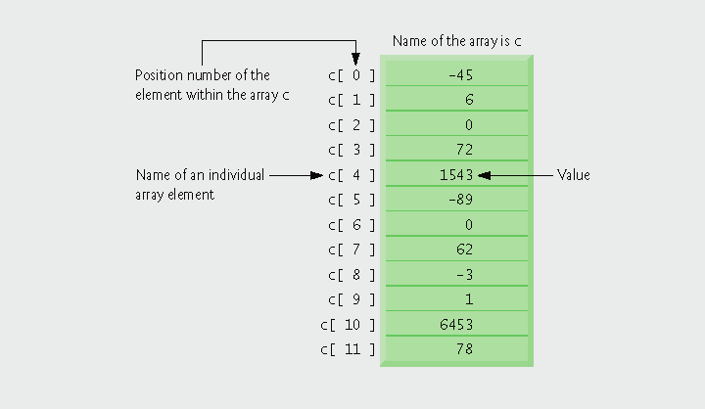
Array of 12 elements
ARRAYS
int c[12];

Slide 23
How to Initialize Array?
Syntax of array initialization:
int values [6] = {1, 5, 10, 25, 50, 100};
Initializing Data
Braces
Commas
Array-Size (Optional)

Slide 24
Various way of Initialization
int ageOfStudent[10]={18,19,18,20,19,19,18,20,18,19};
int ageOfStudent[]={18,19,18,20,19,19,18,20,18,19};
int ageOfStudent[10]={18,19,18}; // seven 0s
int ageOfStudent[2]={18,19,18}; // error!!!

Slide 25
Assigning Values to Individual Array Elements
float temp[5]; int m = 4; // Allocates memory
temp[2] = 98.6;
temp[3] = 101.2;
temp[0] = 99.4;
temp[m] = temp[3] / 2.0;
temp[1] = temp[3] - 1.2;
// Which values are assigned?
7000 7004 7008 7012 7016
99.4 ? 98.6 101.2 50.6
temp[0] temp[1] temp[2] temp[3] temp[4]

Slide 26
What values will be assigned?
int temp[5]; // Allocates memory
int m;
for (m = 0; m < 5; m++)
{
temp[m] = 100 + (m * 0.2) ;
}
7000 7004 7008 7012 7016
? ? ? ? ?
temp[0] temp[1] temp[2] temp[3] temp[4]

Slide 27
Now what values will be printed?
float temp[5]; // Allocates memory
int m;
for (m = 0; m < 5; m++)
{
temp[m] = 100 + (m *0.2) ;
}
for (m = 4; m >= 0; m--)
{
cout << temp[m] << endl;
}
7000 7004 7008 7012 7016
100.0 100.2 100.4 100.6 100.8
temps[0] temps[1] temps[2] temps[3] temps[4]

Slide 28
Indexes
Subscripts can be constants or variables or expressions
If i is 5, a[i-1] refers to a[4] and a[i*2] refers to a[10]
You can use i as a subscript at one point in the program and j as a subscript for the same array later…only the index and value of the variable matters you are referring to!

Slide 29
Variable Subscripts
float temps[5]; // Allocates memory
int m = 3;
. . . . . .
What is temps[m + 1] ?
What is temps[m] + 1 ?
7000 7004 7008 7012 7016
100.0 100.2 100.4 100.6 100.8
temps[0] temps[1] temps[2] temps[3] temps[4]

Slide 30
Find the maximum in the list
int main()
{
int a[10], max;
for(int i = 0; i < 10; i++)
{
cout<<“Enter values for an array “;
cin>>a[i];
}
max = a[0]; // value of the largest element seen so far
for (i = 1; i < 10; i++) // note that loop starts at 1, not 0
{
if (a[i]>max)
max = a[i]; // now max contains the value of the largest element in the list
}
cout<< "The maximum number is " <<max;
}

Slide 31
Size of an Array
The size of an array can be determined using the operator sizeof, for example,
sizeof MY_ARRAY; sizeof(MY_ARRAY);
returns you the size of entire array MY_ARRAY.
But sizeof MY_ARRAY[0];
returns you with the size of the first element of MY_ARRAY, i.e. MY_ARRAY[0].
Therefore, sizeof MY_ARRAY / sizeof MY_ARRAY[0];
gives the number of elements in the array MY_ARRAY.

Slide 32
The boundary of an Array
In C++, it is allowed for one to go outside an array.
No compilation error.
May or may not have a run time error. If our program try to access a memory space allocated to another program, the OS will terminate our program.
The result is unpredictable.

Slide 33
The boundary of an Array(coding)
int main()
{
int num;
int a[10]={0};
for(int j =0; j<20; j++)
cout<<a[j]<<endl;
cout<<sizeof a;
return 0;
}

Slide 34
Memory allocation for an Array
int a[3];
The array variable indicates the beginning address of the memory space.
cout<<a; //0x61fdf0
Address | Identifier | Value
0x61fdf0 | a | ?
0x61fdf4 |  | ?
0x61fdf8 |  | ?

Slide 35
Memory indexing for an Array
int a[3];
The array variable indicates the beginning address of the memory space.
cout<<a; //0x61fdf0
The array index indicates the amount of offset for accessing a memory space.
a[i] means to take the variable stored at starting from a, offset by i unit.
cout<< a+1; //0x61fdf4
Address | Identifier | Value
0x61fdf0 | a | ?
0x61fdf4 |  | ?
0x61fdf8 |  | ?

Slide 36
String as an array of characters
A character array can be initialized using a string literal. For example,
char string1[] = “first”;
The size of array string1 is five characters plus a special string termination character called the null character ‘\0’ (backlash followed by zero). Thus, array string1 contains six characters.
A character array representing a string should be declared large enough to hold the number of characters in the string and the terminating character.
Character arrays can also be initialized with individual character constants in an initializer list. For example,
char string1[] = {‘f’, ‘i’, ‘r’, ‘s’, ‘t’, ‘\0’};

Slide 37
String as an array of characters
Assignments with double quotation marks (“ “) are allowed only for initialization.
char s[10]=” my pet”; //(ok)
char s[10];
s= ” my pet”; // (compilation error)

Slide 38
String as an array of characters
We can access individual characters in a string directly using array subscript notation. For example, string1[0] is the character ‘f’ and string1[3] is the character ‘s’.
We can also input a string directly into a character array from the keyboard using cin and >>. For example,
char string2[20];
Creates a character array capable to store a string of 19 characters and a terminating null character.
The statement
cin >> string2;
reads a string from the keyboard into string2. cin reads characters from the keyboard until the first whitespace character is encountered. It does not care how large the array is.

Slide 39
String as an array of characters
A character array representing a null terminated string can be output with cout statement
The array string2 is printed with the command:
cout << string2 << endl;
but other type of array like int array will print out it memory.
Note that cout << does not care how large the character array is. The characters of the string are printed until a terminating null character is encountered.

Slide 40
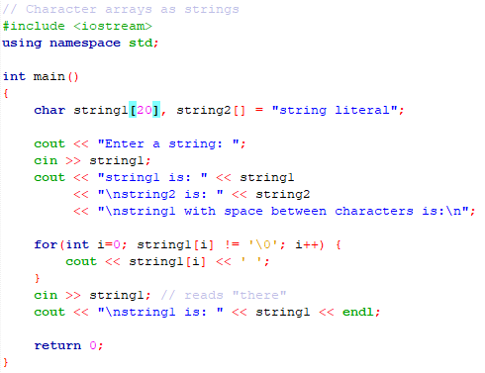
Example: Character arrays as strings

Slide 41
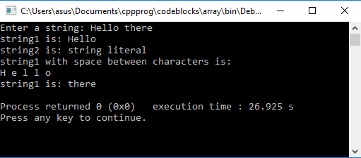
Example: Cont… Program Output

Slide 42
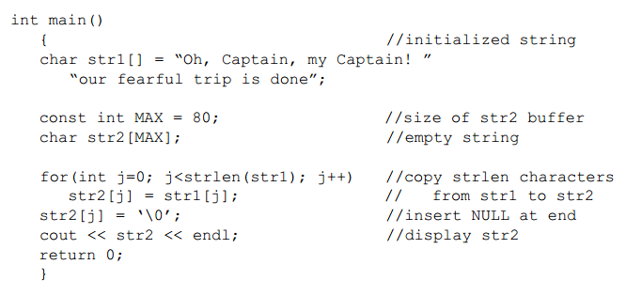
Copying a String – the hard way

Slide 43
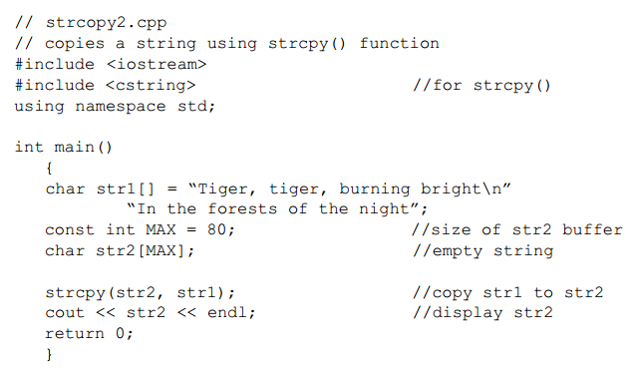

Copying a string – the easy way
Note the Syntax:

Slide 44
You cannot do…
  Suppose you have two array, s1 and s2 with the same length, same type of elements.
  You cannot write s1=s2.
  You cannot compare two arrays with =, <, >, etc..
  This is because s1 and s2 are just two memory addresses.
Compiled by Dr. Hew

Slide 45
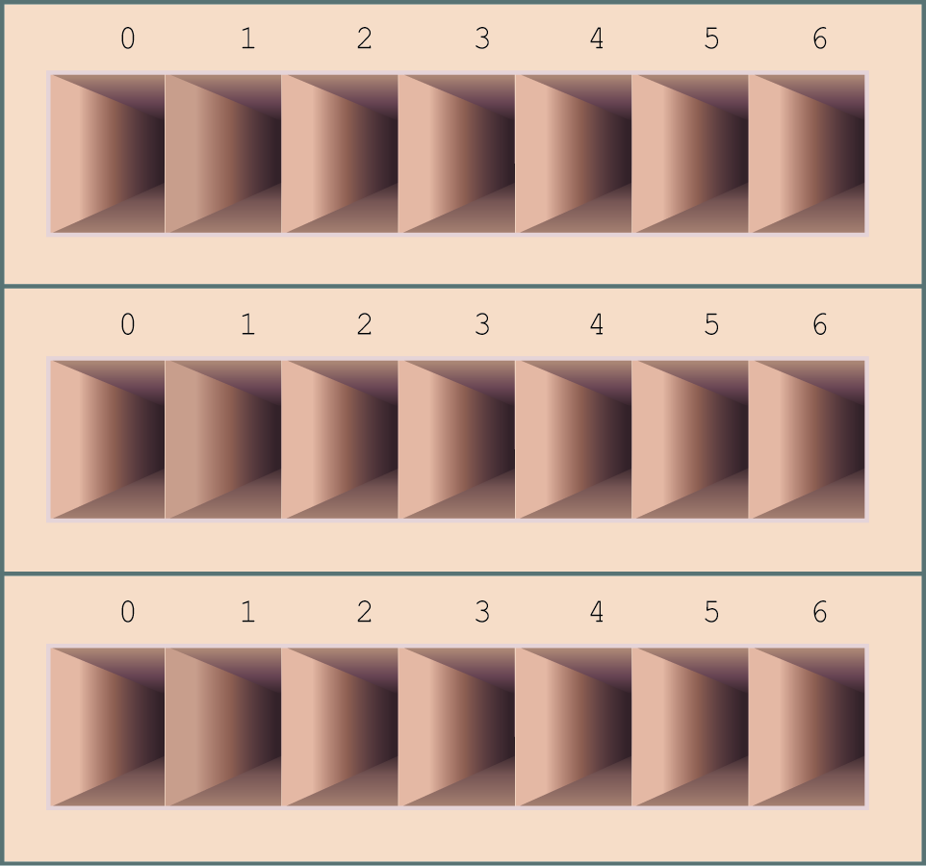
4. Multidimensional Arrays
A two-dimensional array has “rows” and “columns,” and can be thought of as a series of one-dimensional arrays stacked on top of one another.

Slide 46
Two -dimensional Arrays
One subscript for each dimension
Use square brackets for each subscript
Each subscript begins with 0
A 2D array is typically represented as a matrix
Example:
int A[3][4]; // 2D array (matrix) with 3 rows and 4 columns
Col
0
Col
1
Col
2
Col
3
A[0][0]
Row 0
A[1][2]
Row 1
A[2][3]
Row 2

Slide 47
Example
Rows of a 2D Array
a[0][0] a[0][1] a[0][2] a[0][3] row 0
a[1][0] a[1][1] a[1][2] a[1][3] row 1
a[2][0] a[2][1] a[2][2] a[2][3] row 2
Notes:
What about #bytes/element of array? Excluded in above analysis.

Slide 48
Columns of a 2D Array
a[0][0] a[0][1] a[0][2] a[0][3]
a[1][0] a[1][1] a[1][2] a[1][3]
a[2][0] a[2][1] a[2][2] a[2][3]
column 0
column 1
column 2
column 3
Notes:
What about #bytes/element of array? Excluded in above analysis.

Slide 49
Initializing a 2D array
As with 1D arrays, values can be loaded into two dimensional arrays:
explicitly (referring to each element by its indices) or
using a list
Example: Loading values into a matrix explicitly
int A[2][3]; // 2D array (matrix) with 2 rows and 3 columns
A[0][0] = 1;
A[0][1] = 2;
A[0][2] = 3;
A[1][0] = 4;
A[1][1] = 5;
A[1][2] = 6;
Results for matrix A:
1 | 2 | 3
4 | 5 | 6

Slide 50
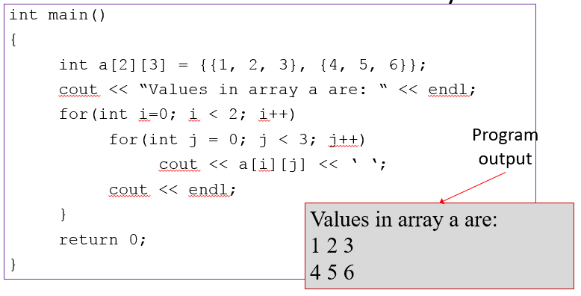
Using ‘for’ loop

Slide 51
References
  Problem Solving with C++ (10th Edition), Walter Savitch, Addison Wesley, 2018
  Paul J. Dietel, C++ How to Program (10th Edition), Pearson, 2017.
  Turbo C programming for the PC, Robert Lafore
  Dr. Kamran’s notes.
Compiled by Dr. Hew

Slide 52
Solution (Challenge !)
  int main()
  {
  char c;
  cout<<" 0 1 2 3 4 5 6 7 8 9\n";
  cout<<" 3 ";
  for(int i=33; i<126;i++)
  {
  if(i%10==0)
  {
  if(i%10<=9)
  cout<<" ";
  cout<<i/10;
  }
  c =i;
  cout<<" "<<c;
  if(i%10==9)
  cout<<endl;
  }
  return 0;
  }
Compiled by Dr. Hew

